Slide 1

Nashville , TN
O’FALLON TOWNSHIP
HIGH SCHOOL
JUNE 10-13, 2024

Slide 2
BRT: Since 1981
Founded and owned by a band director
Executed over 6,500 tours
Disney Youth Programs PremEar Travel Planner
The top producer for Disney Performing Arts OnStage programs at the Walt Disney World® Resort
Recipient of Disney’s prestigious Partners Award
Member of the Student & Youth Travel Association and the National Tour Association
Sponsor of the Illinois Music Education Association, the National Band Association, the American Choral Directors Association, among others
Corporate sponsor of the Make-A-Wish Foundation

Slide 3

Trip Highlights
Recording Session at RCA Studio B
Vanderbilt University Clinic
Performance outside the Grand Ole Opry
Grand Ole Opry Show
Honky Tonk Party!

Slide 4

Itinerary - Monday, June 10, 2024
9AM – Motor coaches arrive at O’Fallon Township HS
10AM – Depart for Nashville, TN!
4:30PM – Arrive in Nashville at Top Golf and enjoy dinner and golfing!
8PM – Check in to your hotel

Slide 5
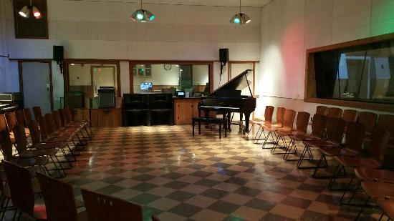
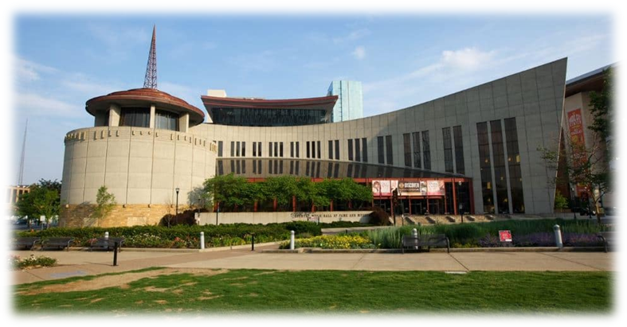


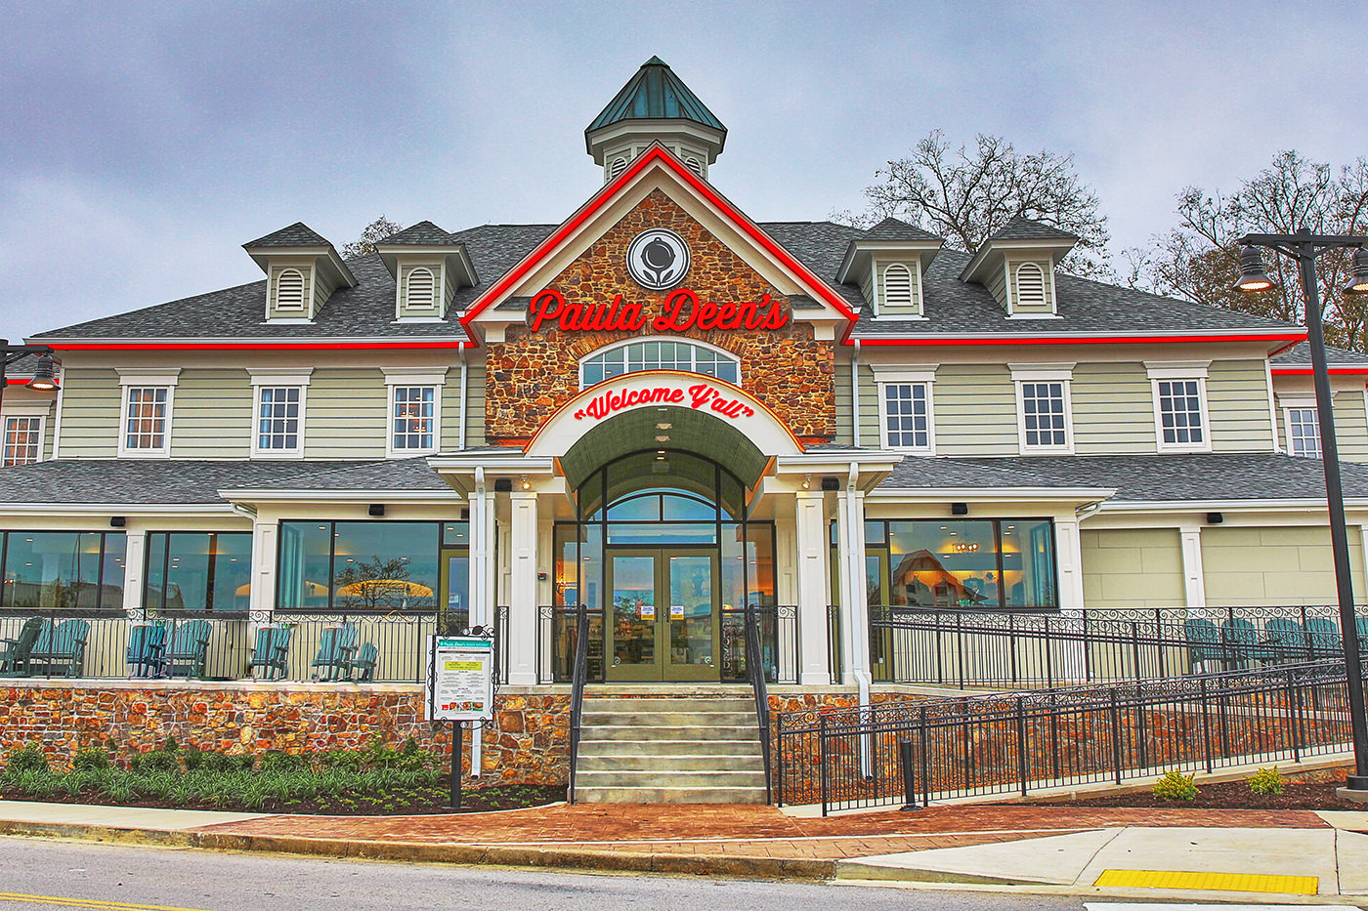
Itinerary - Tuesday, June 11, 2024
AM – Tour RCA Studio B – Participate in a recording session
11AM – Tour the Country Music Hall of Fame
PM – Opry Mills Mall lunch (student cost)
2PM – Backstage Tour of the Grand Ole Opry
4:30PM – Early Group dinner at Paula Deen’s Family Kitchen
PM – Performance outside the Grand ole Opry
7PM – Enjoy a Grand Ole Opry Performance!

Slide 6

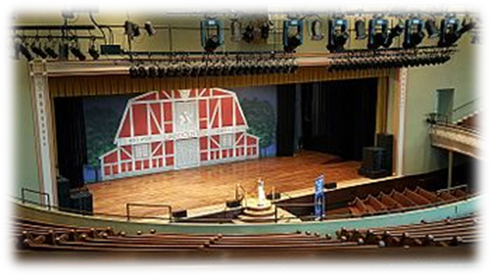


Itinerary - Wednesday, June 12, 2024
AM – Vanderbilt University Clinic/tour
AM – Belmont University Tour
PM – Lunch at the Nashville Farmers Market (student cost)
2:45PM – Tour the Ryman Auditorium
5:30PM – Dinner at Ole Red
PM – Walk the Seigenthaler Pedestrian Bridge

Slide 7
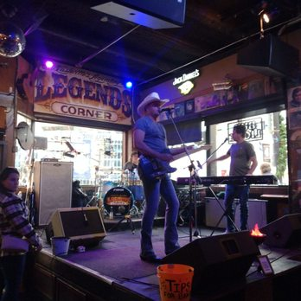
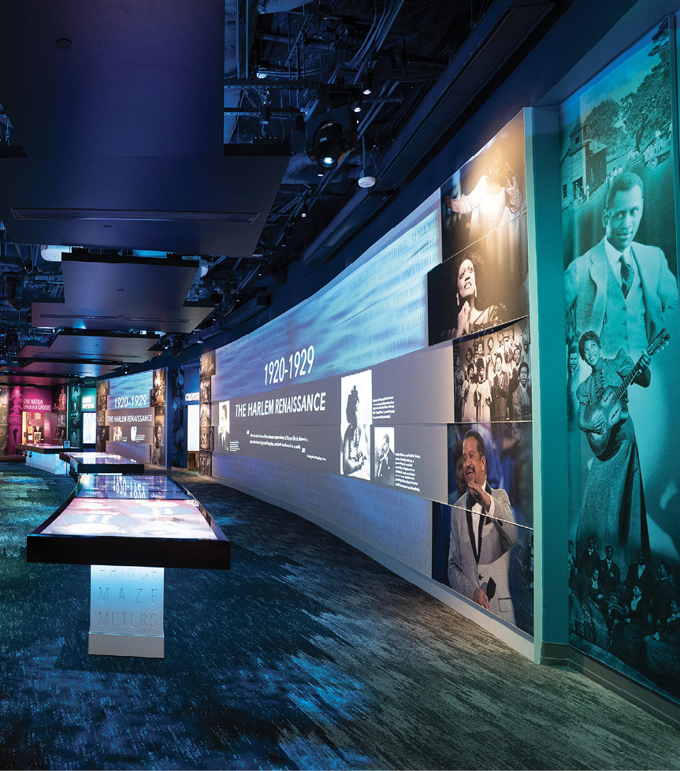

Itinerary - Thursday, June 13, 2024
9AM – Honky Tonk Party at Legends Corner
11:15AM – Tour the National Museum of African American Music
1:30PM – Farewell Lunch at Hard Rock Café
3PM – Depart for home
9:30PM – Approximate arrival at O’Fallon Township HS

Slide 8

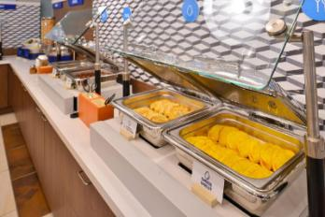
Accommodations – Holiday Inn Express Nashville Airport
Full buffet breakfast each morning
1111 Airport Center Dr, Nashville, TN 37214
(615) 883-1366

Slide 9
Trip Inclusions
2 - 56 passenger motor coaches
Gratuities for your motor coach drivers
3 Nights’ accommodations at Holiday Inn Express Nashville Airport
Hotel Room for the Motor Coach Driver(s)
Breakfast at hotels
All Students will pay Quad Occupancy Price (Quad Occupancy must be maximized)
Group Dinner at Ole Red
Group Meal at Paula Deen's Family Kitchen
Group Lunch at Hard Rock Cafe
Excursion to the John Seigenthaler Pedestrian Bridge
Excursion to Nashville Farmers' Market
Excursion to Downtown Nashville
Admission to the Legends Corner Honky Tonk Party
Admission to the National Museum of African American Music with interactive Wristband
Admission and Group Meal at Top Golf
Backstage Tour of the Grand Ole Opry
Ticket to Grand Ole Opry
Self Guided Tour of the Ryman
CD of your recording at RCA Studio B
Admission to the RCA Studio B Tour and Recording
Admission to the Country Music Hall of Fame Museum
Excursion to Opry Mills Mall
Campus Tour at Vanderbilt University
Campus Tour at Belmont University
Group Performance in the Opry House Plaza
Honorarium for Choir Clinic at Vanderbilt University
1 Onsite Company Tour Director(s)
BRT Video Souvenir & Tracking/Messaging App
BRT Drawstring bag for every participant
BRT Payments - Online Payment System
BRT Luggage Tags

Slide 10
Payment Schedule
Participant Type | Occupancy
Student | $999.00 (all students in quad occupancy)
Chaperone | $1,158.00 (double occupancy) $1,475.00 (single occupancy)
Payment Details | Due Date | Amount Due
Registration Deadline | September 29, 2023 | ---
Deposit + Insurance Premium (if selected) | October 6, 2023 | $100.00 per traveler
2nd Payment | November 17, 2023 | $200.00 per traveler
3rd Payment | January 12, 2024 | $200.00 per traveler
4th Payment | February 23, 2024 | $200.00 per traveler
Final Payment | April 19, 2024 | Remaining Balance

Slide 11
BRT Payments
Secure, online payment system
All payments processed automatically online per the payment schedule.
Ability to opt-in for travel protection
  Automatically takes out the premium at the same time as the deposit
Ability to pay with ACH (E-check) or pay via credit card (additional 3% credit card fees)
https://bobrogerstravel.grcoll.co/go/ofallonhsc24
Trip Code: OFALLONHSC24

Slide 12
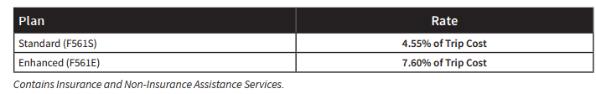
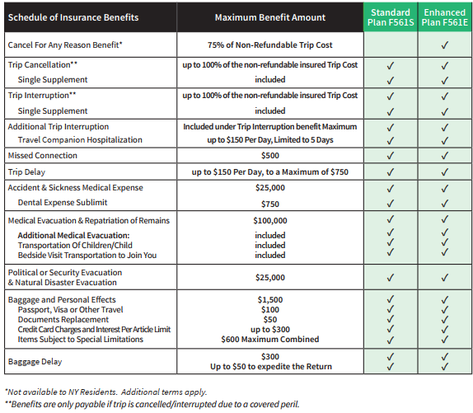
Travel Insurance
Highly recommend the Enhanced Plan F561E (with Cancel for Any Reason coverage)

Slide 13

Questions?
Email: travelersupport@bobrogerstravel.com
Thank you for the opportunity to plan the trip of a lifetime for your group!

